Slide 1


Advanced Certificate Programme
in Machine Learning, Gen AI & LLMs for Business Applications
Session 1
Large Language Models
Fundamentals
Dr. Ramji Srinivasan
Adjunct Professor & Senior Consultant, IIT Madras | Facilitator, IITM Pravartak & Jaro Education
Co-founder & Director, Bit2Qubit Technologies Ltd | Scientific Advisor, ParvAI Labs & Sonolight Imaging
19 July 2026

Slide 2
Agenda
Learning from Phase I
Phase II- Modules & Execution Plan
Foundations of LLM
  Natural Language Processing
  Language Model
      Rule based
      Statistical
      Neural
      Introduction to Large Language Models
Broad Review of Applications of LLM
Market Trends
References / Useful Reads
Hands On

Slide 3
Phase I
Topics covered in Phase I
Mathematical Foundations for AI & ML
Probability & Statistics for ML
Machine Learning Fundamentals
Classical ML Algorithms
Neural Networks & Deep Learning
Computer Vision Techniques
Sequential & Representation Learning
Advanced Learning Paradigm

Slide 4
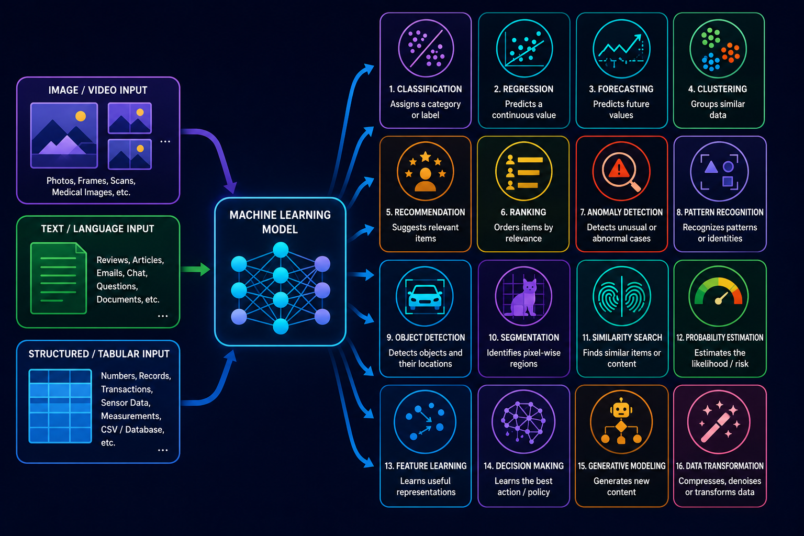


Machine Learning - Capabilities
Discriminative
Learns to predict classes
Input → Output: Features → Class/Value
Decision Boundary: P(label | input) directly
E.g. Classification, Regression
"Given an email, is it spam or not?"
Generative
Learns to generate data
Input → Output: Input → New data
Decision Boundary: P(input, label) or P(input)
E.g. GANs, VAEs
"Write a new email that looks like a real email."

Slide 5
Machine Learning - Capabilities

Slide 6
Phase II
Modules to be covered in Phase II
Foundations of Large Language Models (LLM)
Training and Scaling LLM
Prompt Engineering
Fine-Tuning and Model Adaptation
Retrieval-Augmented Generation
AI Agents and Agentic Systems
Multimodal LLM
Productionizing AI Application

Slide 7
Module 1
Module 1: Foundations of Large Language Models (LLM)
  Section 1 (19/07/26): Evolution of Language Models
    • AI Taxonomy • Evolution of Language Models • Statistical Language Models • Neural Language Models • Large Language Models • Market Trends
  Section 2 (16/08/26): Transformers and Foundation Models
    • Attention Mechanism • Transformer Architecture Overview • Tokenization • Embeddings • Positional Encoding • Self-Attention • Encoder vs Decoder Architectures • Foundation Models • Modern LLM Landscape

Slide 8
Execution Plan for Module 1
DATE | PLAN
19-07-2026 (Sun) | Theory: Evolution of Language Models Practical: Installation & Setup complete
16-08-2026 (Sun) | Theory: Transformers and Foundation Models Practical: Installation & Setup complete, NLP, Evolution of LLM
22-08-2026 (Sat) | Practical: Explore Hugging Face Hub, Analyze Model Cards, Compare GPT-2/FLAN-T5/Llama Outputs, Experiment with Temperature/Top-K/Top-P, Prompt-Response Analysis Practical: Tokenization Experiments, BPE Token Visualization, Embedding Visualization, Attention Visualization, Comparing Encoder vs Decoder Models
23-08-2026 (Sun)

Slide 9
Advanced Certificate Programme in Machine Learning, Gen AI & LLMs for Business Applications
Foundations of LLMs
Section 1: Evolution of Language Models

Slide 10
Advanced Certificate Programme in Machine Learning, Gen AI & LLMs for Business Applications
Foundations of LLMs
Section 1: Evolution of Language Models
Part 1: Introduction to Language Model

Slide 11
Setting Up the Stage for Language Models
What is Natural Language Processing (NLP)?
Branch of AI that enables computers to understand, analyze, generate, and process language
Works with both text and speech
Human languages are:
    • Ambiguous Context-dependent • Grammatically complex • Continuously evolving
The goal of NLP: Bridge the gap between human communication and machine understanding
Eg: Google Translate, Siri, Alexa, ChatGPT, Email spam detection, Grammar correction, Sentiment analysis, Search engines

Slide 12
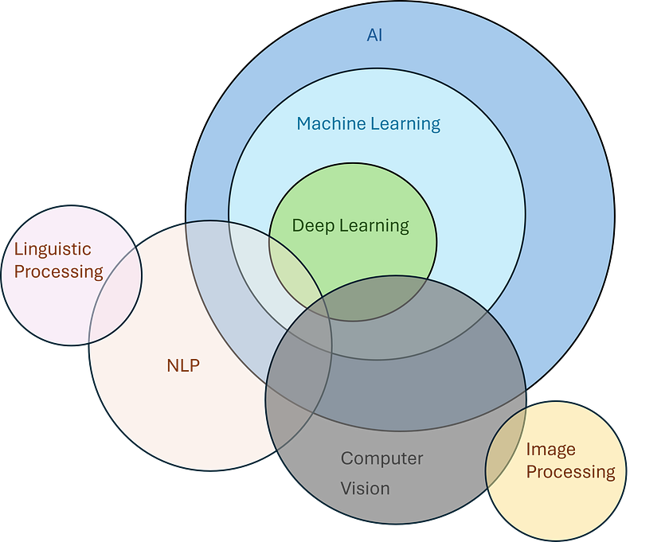
Natural Language Processing

Slide 13
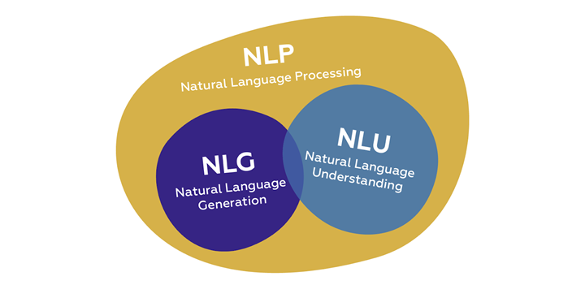
Components of NLP
It consists of two major components:
Natural Language Understanding (NLU):
  enabling a computer to interpret, comprehend, and extract meaning from language.
Natural Language Generation (NLG)
  enabling a computer to produce meaningful, and appropriate human language.

Slide 14
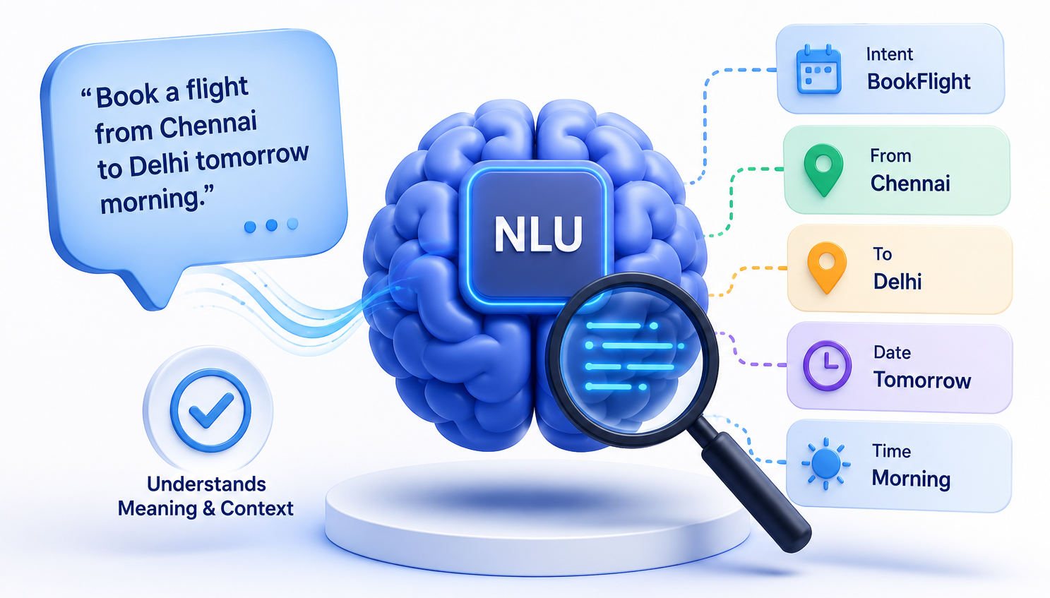
Natural Language Understanding
NLU enables a machine to extract information such as:
Intent – What does the user want?
Entities – Who, what, where, and when?
Context – What is the conversation about?
Sentiment – Is the text positive/negative/neutral?
Relationships – How are words connected?
Common Tasks
Task | Description
Part-of-Speech Tagging | Identify nouns, verbs, adjectives, etc.
Named Entity Recognition | Detect people, locations, organizations, dates
Intent Detection | Identify the user's goal
Sentiment Analysis | Positive, negative, or neutral sentiment
Topic Classification | Categorize text into predefined topics
Semantic Parsing | Convert language into structured meaning
Question Understanding | Interpret questions accurately
Relation Extraction | Identify relationships between entities

Slide 15
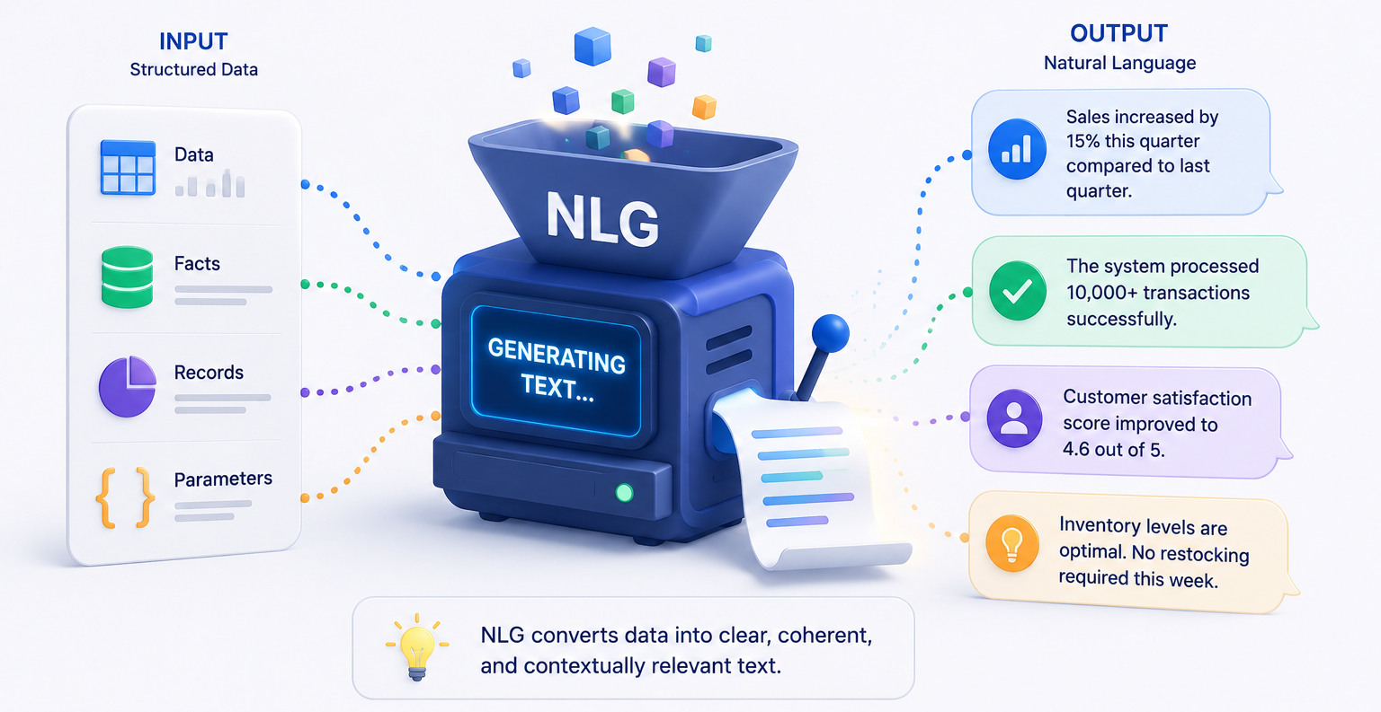
Natural Language Generation
NLG enables a machine to:
Generate natural, human-like text
Answer user questions
Summarize long documents
Translate between languages
Common Tasks
Task | Description
Text Generation | Produce sentences or paragraphs
Machine Translation | Translate between languages
Text Summarization | Create concise summaries
Question Answering | Generate answers to questions
Dialogue Generation | Produce conversational responses
Story Generation | Write stories or narratives
Report Generation | Convert structured data into reports
Code Generation | Generate programming code
Email Drafting | Compose professional emails

Slide 16
Language Models in NLP?
Can we develop models for language understanding and generation?
NLP
NLU
NLG
Understanding
Generation
LM

Slide 17
What is a Language Model?
A Language Model (LM)
  Model that learns the patterns, structure, and relationships of human language
  Model that can help predict, understand, and generate natural language.
Key Characteristics
  Learns from large text corpora.
  Captures grammar, context, and meaning.
  Estimates the likelihood of the next word or piece of text.

Slide 18
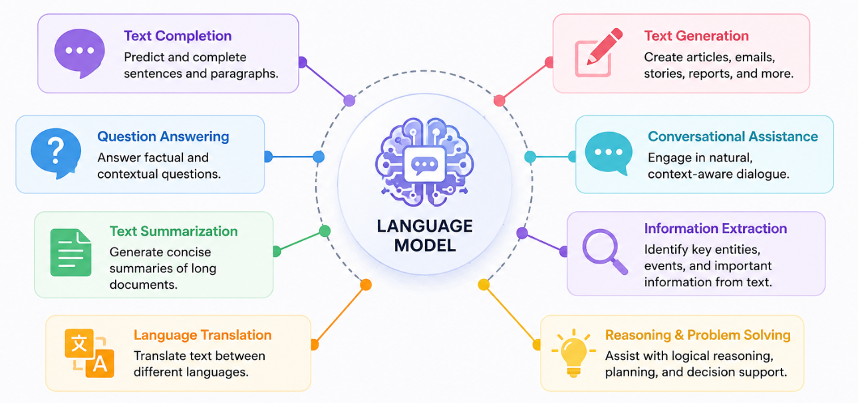
Capabilities of Language Model

Slide 19
Advanced Certificate Programme in Machine Learning, Gen AI & LLMs for Business Applications
Foundations of LLMs
Section 1: Evolution of Language Models
Part 2: Evolution of Language Models

Slide 20
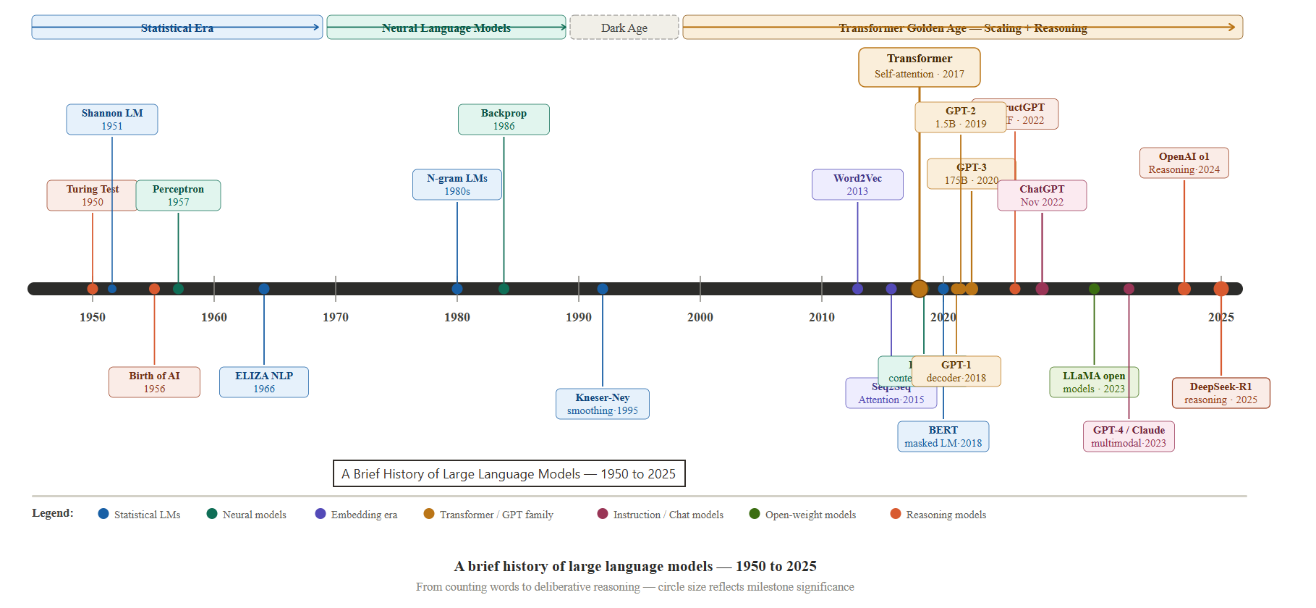
Evolution - Timelines

Slide 21
Evolution of Language Model
Rule-Based Language Models (1950s–1980s)
Handcrafted grammar rules, Dictionaries and linguistic knowledge
Statistical Language Models (1990s–2010)
N-grams, Hidden Markov Models (HMMs), Probabilistic approaches
Neural Language Models (2010–2016)
Feedforward Neural Networks, RNN, LSTM / GRU, Sequence-to-Sequence Models
Large Language Models (2017–Present)
  GPT, Llama, Gemini, Claude, Qwen, DeepSeek, etc.
RNN – Recurrent Neural Networks, LSTM - Long Short Term Memory, GRU – Gated Recurrent unit, GPT- Generative Pretrained Transformer

Slide 22
Rule-Based Language Models
Relied on explicitly defined linguistic rules and symbolic knowledge representations to process and understand human language
Key Characteristics
  Grammar and syntax encoded using if–then rules.
  Relied on lexicons (dictionaries) containing words and their linguistic properties.
  Deterministic behaviour—identical input always produced identical output.
ELIZA Example
User:
I feel sad.
Rule:
IF input contains "I feel X"
THEN respond:
"Why do you feel X?"
Output:
Why do you feel sad?
Examples
ELIZA (1966) – Pattern-matching conversational system.
SHRDLU (1970) – Natural language understanding in a constrained "blocks world."

Slide 23
Statistical Language Models
A language model estimates the probability of any sequence of words
Assign probabilities to sequence of words
  count word sequences in a corpus and turns counts to probabilities
  trained on counts computed from lots of text
  generate text by sampling possible next words

Slide 24
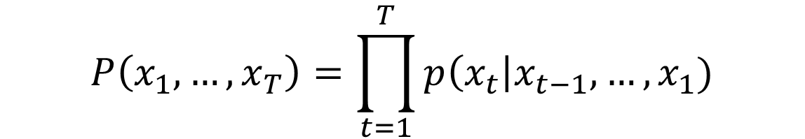
Statistical Language Models – N-gram
W = <s> I want Indian food </s>;
w₁
w₂
w₃
w₄
Condition each word on its immediate ‘n’ predecessor (look at ‘n’ previous words or window size of n)
This compounds for all subsequent events, too
The likelihood of any event occurring hinges upon all prior events occurring

Slide 25
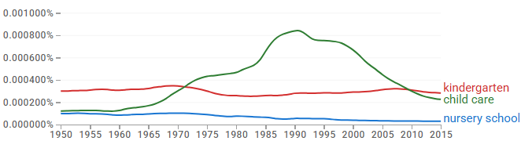
Statistical Language Models – Challenges
Google N-Gram Release, August 2006
  Google research has been using word n-gram models for R&D
  Google processes 1,024,908,267,229 words of running text and are publishing the counts for all 1,176,470,663 ‘five-word’ sequences that appear at least 40 times. There are 13, 588,663 unique words after discarding words that appear less than 200 times
Google N-Gram Viewer, July 2024
  When you enter a phrase, the viewer shows how the phrase occurred in a corpus of books
  You can now include up to 7-words in your N-gram viewer

Slide 26
Statistical Language Models - Limitations
  Limited contextual understanding
  Smaller context windows
  Unsustainable approach to handling increasingly larger contexts
  Struggles with complex language structures
    No semantic information conveyed by counts (e.g., vehicle vs car)
    Cannot leverage non-consecutive patterns (Dr. S. Ravi Vs Dr. Sam Ravi)
  Poor scalability due to high storage and compute requirements
WHY IT MATTERS
Led to the development of neural language models.

Slide 27
Neural Language Models
Words represented as feature vectors
Eg Convert each unique word in a dictionary to an index
W = <s> I want Indian food </s>;
w₁
w₂
w₃
w₄

Slide 28




Neural Language Models
W = <s> I want Indian food </s>;
w₁
w₂
w₃
w₄
Feed forward neural network
want
Output layer
Hidden layer
Example input word
I

Slide 29



















Neural Language Models - RNN
W = <s> I want Indian food </s>;
w₁
w₂
w₃
w₄
Output layer
RNN
Input layer

Slide 30

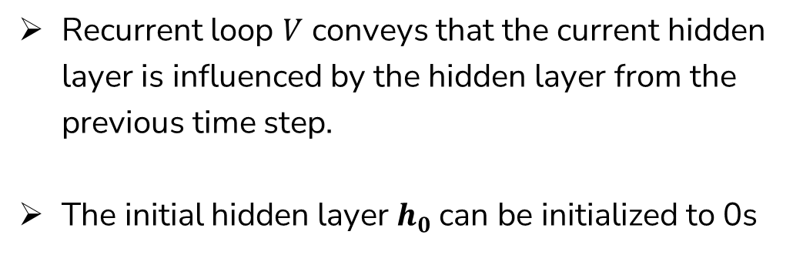



Neural Language Models - RNN
Words represented as feature vectors
W = <s> I want Indian food </s>;
w₁
w₂
w₃
w₄
Output layer
RNN
Hidden layer
Input layer

Slide 31
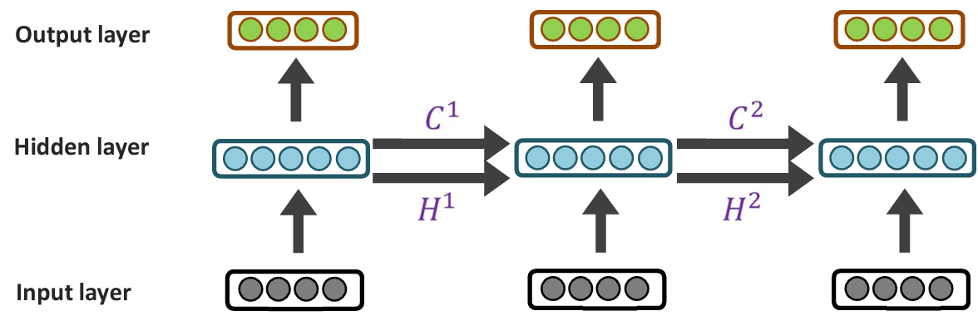
Neural Language Models - LSTM
W = <s> I want Indian food </s>;
w₁
w₂
w₃
w₄
x1 x2 x3

Slide 32
Neural Language Models - Limitations
01
Slow in training
Sequential processing prevents parallelization across time steps.
02
Vanishing / exploding gradients
Gradients can shrink or blow up as they propagate across many steps.
03
Limited long-range context
Issues with making use of long-range context in practice.

Slide 33
Advanced Certificate Programme in Machine Learning, Gen AI & LLMs for Business Applications
Foundations of LLMs
Section 1: Evolution of Language Models
Part 3: Introduction to Large Language Models (LLMs)

Slide 34
Large Language Models
LLMs are Language Models scaled to a much larger size and capability.
More Data ! Availability of web-scale text, books, scientific literature, and code repositories.
More Compute ! Advances in GPUs, TPUs, and distributed training enabled models with billions of parameters.
Better Architectures ! Improved neural network architectures, particularly the Transformer, enabled efficient learning from massive datasets and long-range context.
Language Model
(Transformer Based)
+
Data
(Massive)
+
Compute
(TPU)
Large
Language Models

Slide 35
What is a Large Language Model?
A Large Language Model (LLM)
  neural language model trained on massive datasets using the Transformer architecture
  scaled with billions of parameters to understand and generate human language
Key Characteristics
  Trained on massive text corpora.
  Built using the Transformer architecture.
  Contains millions to billions of parameters.
  Learns general language patterns.
  Performs multiple NLP tasks using a single model.

Slide 36
Scale of Modern LLM Training
Model | Parameters | Training Data | Compute Infrastructure
GPT-3 (2020) | 175 Billion | ~300 Billion tokens | Large GPU supercomputers
Llama 3.1 (2024) | 405 Billion | ~15 Trillion tokens | Meta's large-scale GPU clusters (~24K GPUs reported)
Claude 3 | Not publicly disclosed | Public web, text, code, multimedia | Large GPU clusters (details undisclosed)
Gemini | Not publicly disclosed | Text, images, code, video | Google's TPU infrastructure (details undisclosed)

Slide 37
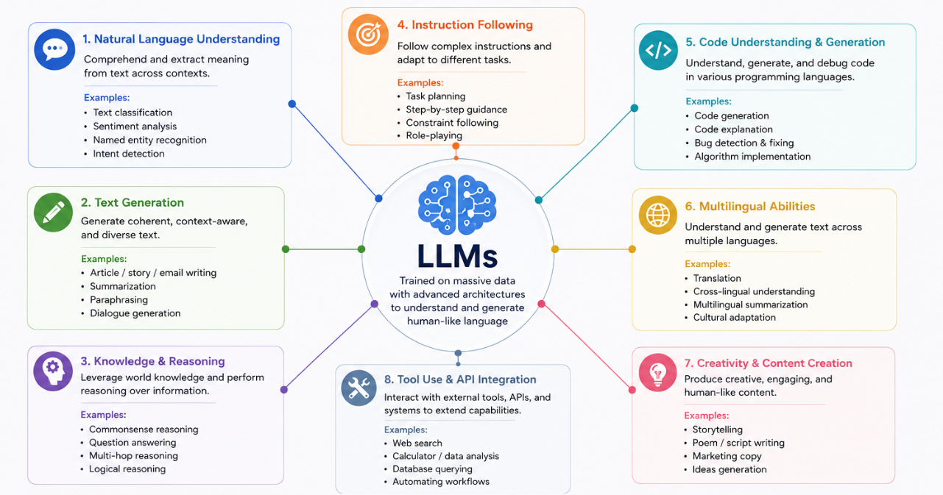
Capabilities of LLMs

Slide 38
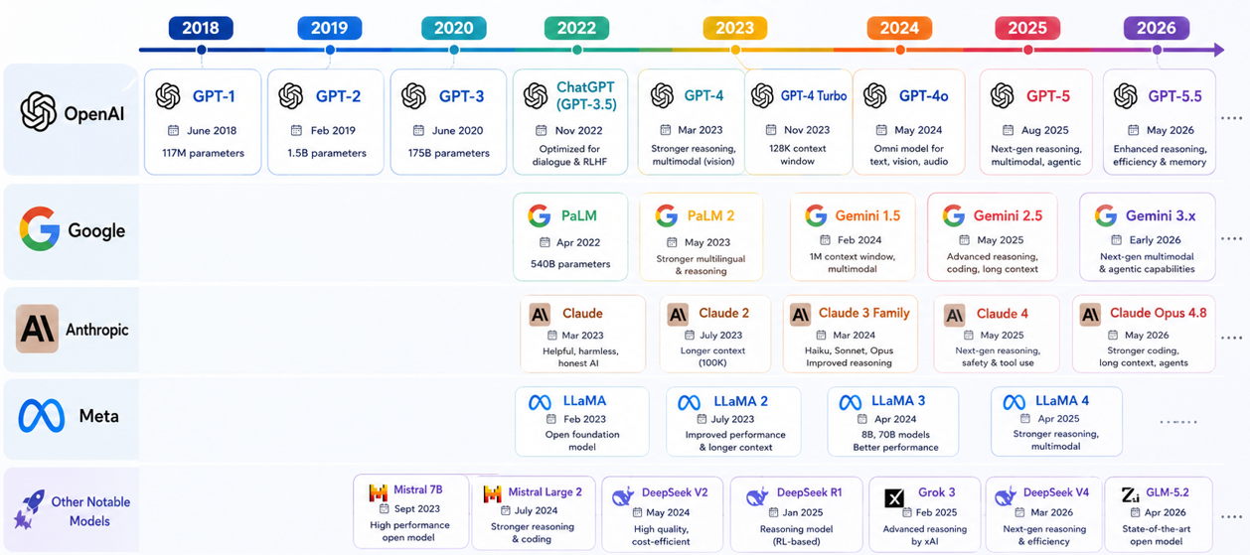
Evolution of Major LLMs

Slide 39
Prominent Capability: Language Generation
What is Language Generation?
Ability of an LLM to produce fluent, coherent, and contextually relevant text from a user input.
Key Features
  Generates human-like responses.
  Understands the context of the conversation.
  Completes sentences and paragraphs.
  Produces new content instead of retrieving predefined responses.
  Adapts its writing style to the user's instructions.

Slide 40
Prominent Capability: Language Generation
The
future
of
AI
is
generative.
Each new token is generated the same way — one probable next piece of text at a time.
Each token is the model's most probable next prediction.
Repeated predictions generate text, code, and conversations.
This generation loop powers modern LLMs.

Slide 41
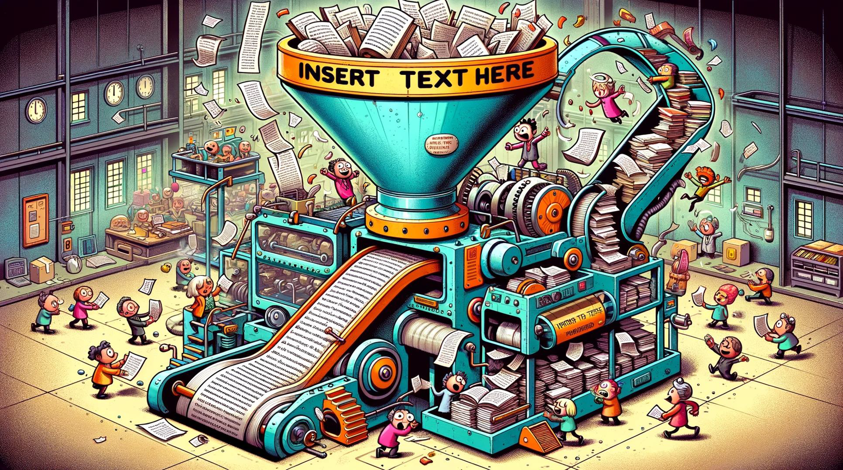
Prominent Capability: Language Generation

Slide 42
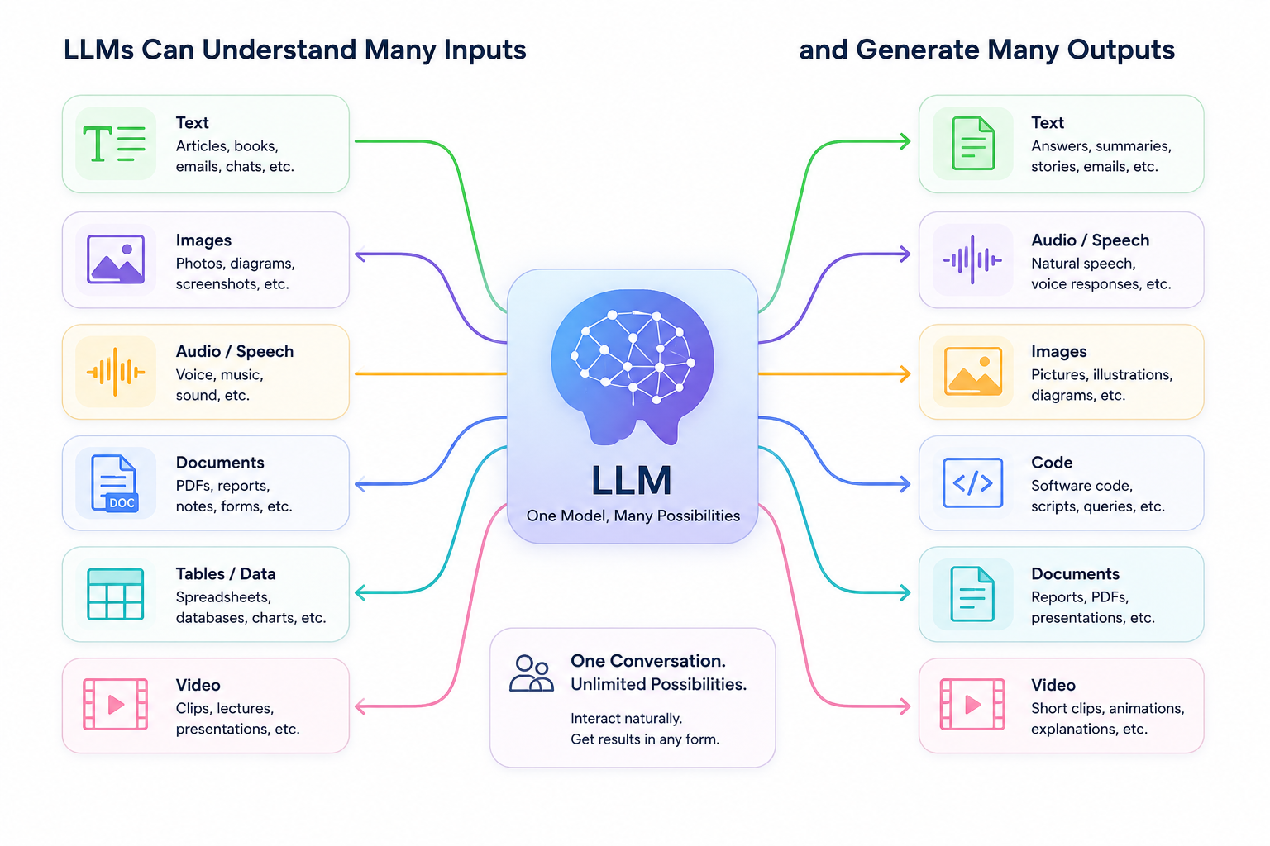
Beyond Text: Modern LLMs
Modern LLMs have evolved to understand and generate multiple types of information, including text, images, audio, documents, code, and videos

Slide 43
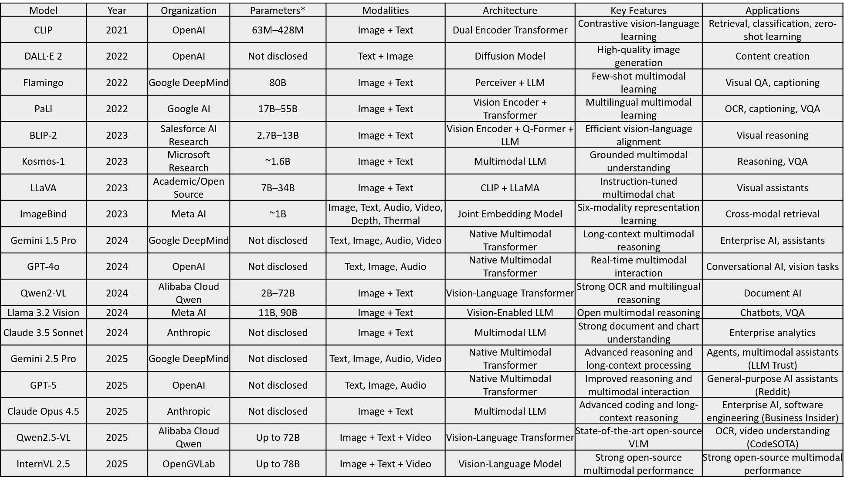
Beyond Text: Modern LLMs

Slide 44
Comparison – Language Models
Model family | Core idea | Strengths | Limitations | Context handling | Typical use today
Statistical Language Models | Estimate next-word probabilities from observed word frequencies (e.g., N-grams) | Simple, interpretable, fast inference, low compute | Sparse data problem, poor generalization, no semantic understanding, fixed context | Very short (typically 2–5 previous words) | Historical systems, educational purposes, some embedded or low-resource applications
Neural Language Models (RNN, LSTM, GRU) | Learn distributed word representations and sequence patterns using recurrent neural networks | Better generalization, captures semantic relationships, handles variable-length sequences | Sequential computation limits scalability, difficult long-range dependencies, slower training | Moderate (tens to hundreds of tokens in practice) | Legacy NLP pipelines, speech recognition, time-series and sequence modeling
Large Language Models (Transformers) | Learn language using self-attention across tokens and large-scale pretraining | Strong generation, reasoning, multitask learning, transfer learning, in-context learning | High compute cost, hallucinations, alignment/safety challenges, limited interpretability | Long (thousands to millions of tokens depending on architecture) | Chatbots, copilots, RAG systems, coding assistants, search, agents, multimodal AI

Slide 45
Advanced Certificate Programme in Machine Learning, Gen AI & LLMs for Business Applications
Foundations of LLMs
Section 1: Evolution of Language Models
Part 3: Applications and Trends of Large Language Models (LLMs)

Slide 46
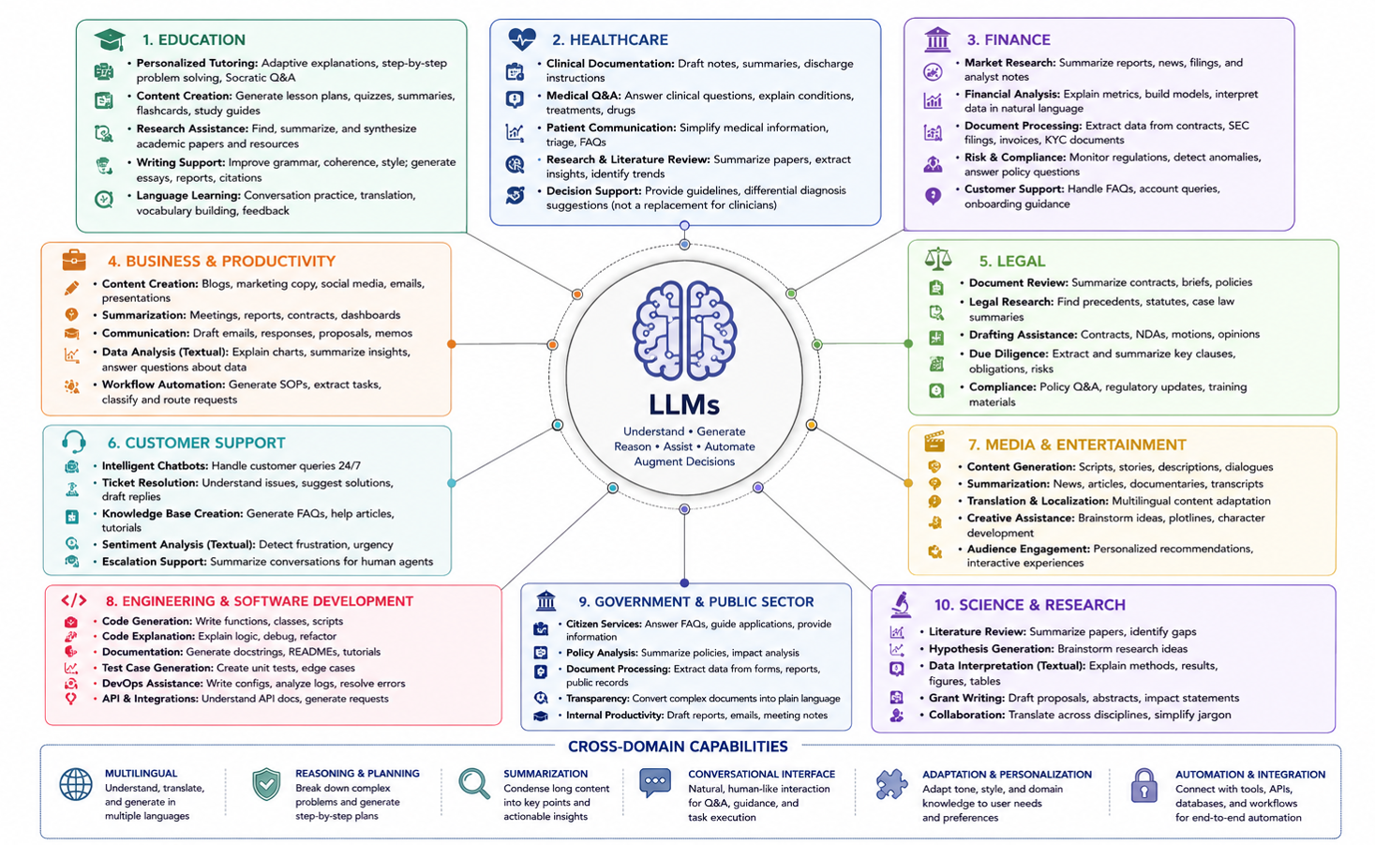
Applications across Domains

Slide 47
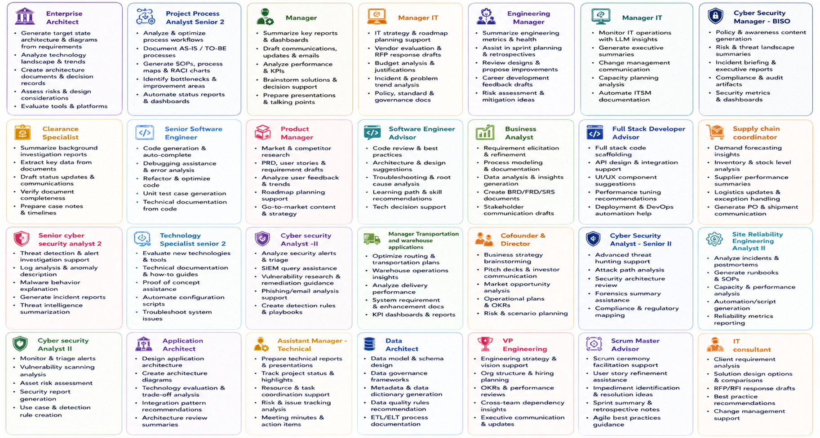
Applications across Roles

Slide 48
LLMs: Market Impact
Global Economic Impact
  US$15.7 Trillion contribution to the global economy by 2030 (PwC).
  US$2.6–4.4 Trillion annual economic value from Generative AI (McKinsey).
  ~7% increase in global GDP over the next decade (Goldman Sachs).
Workforce Transformation
  300 Million jobs could be significantly affected (Goldman Sachs).
  78 Million net new jobs expected by 2030 (World Economic Forum).
Enterprise Adoption
  80%+ of enterprises expected to adopt Generative AI by 2026 (Gartner).
  20–45% productivity improvement for software developers (McKinsey).

Slide 49
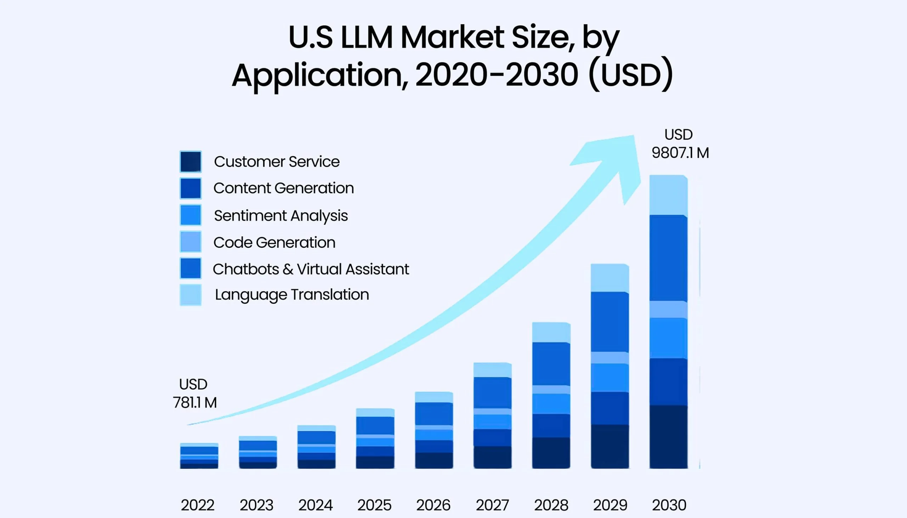
LLMs: Market Impact
Industry Outlook for LLMs
By 2027, LLMs are expected to power 70% of NLP applications (up from <5% in 2022) (Gartner).
LLMs could increase annual labor productivity by 0.1–0.6%, with broader AI-driven automation boosting productivity growth by up to 3.4 percentage points (McKinsey).
72% of organizations plan to increase LLM investments, and 40% already spend over $250K annually on LLM initiatives (Forbes).
https://tkxel.com/blog/how-large-language-models-shape-future/

Slide 50
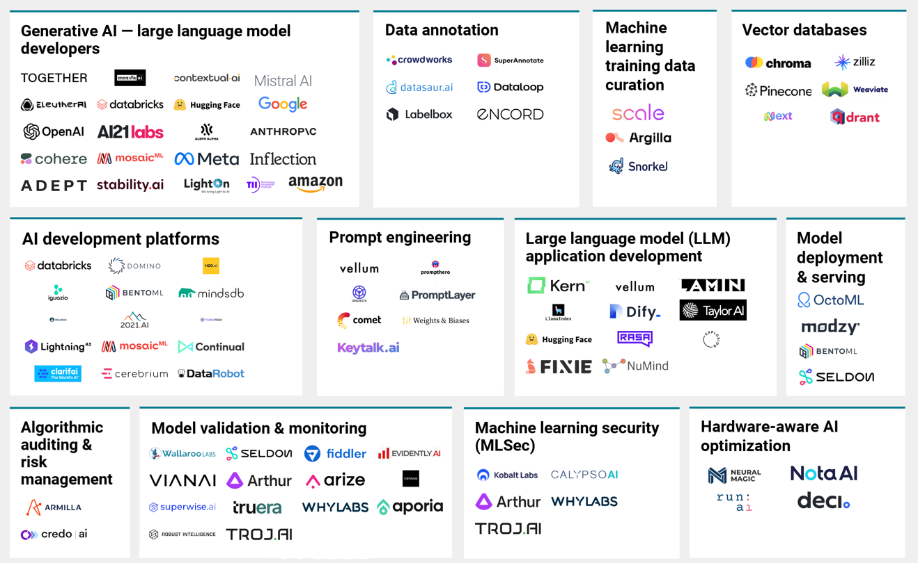
LLMs: Market Map

Slide 51
References
C. D. Manning and H. Schütze, Foundations of Statistical Natural Language Processing. Cambridge, MA, USA: MIT Press, 1999.
D. Jurafsky and J. H. Martin, Speech and Language Processing, 3rd ed. (Draft). Pearson, 2025. Available: https://web.stanford.edu/~jurafsky/slp3/
T. Mikolov, M. Karafiát, L. Burget, J. Černocký, and S. Khudanpur, "Recurrent neural network based language model," in Proc. Interspeech, Makuhari, Japan, 2010, pp. 1045–1048.
Y. Bengio, R. Ducharme, P. Vincent, and C. Janvin, "A Neural Probabilistic Language Model," Journal of Machine Learning Research, vol. 3, pp. 1137–1155, 2003.
A. Vaswani et al., "Attention Is All You Need," in Advances in Neural Information Processing Systems (NeurIPS), vol. 30, 2017.
A. Radford et al., "Language Models are Unsupervised Multitask Learners," OpenAI Technical Report, 2019.
T. B. Brown et al., "Language Models are Few-Shot Learners," Advances in Neural Information Processing Systems (NeurIPS), vol. 33, pp. 1877–1901, 2020.
J. Devlin, M.-W. Chang, K. Lee, and K. Toutanova, "BERT: Pre-training of Deep Bidirectional Transformers for Language Understanding," in Proc. NAACL-HLT, Minneapolis, MN, USA, 2019, pp. 4171–4186.
OpenAI, "GPT-4 Technical Report," 2023.
J. Kaplan et al., "Scaling Laws for Neural Language Models," arXiv preprint arXiv:2001.08361, 2020.
J. Hoffmann et al., "Training Compute-Optimal Large Language Models," arXiv preprint arXiv:2203.15556, 2022.
J. Wei et al., "Emergent Abilities of Large Language Models," Transactions on Machine Learning Research (TMLR), 2022.
McKinsey Global Institute, The Economic Potential of Generative AI: The Next Productivity Frontier, Jun. 2023.
PwC, Sizing the Prize: What's the Real Value of AI for Your Business and How Can You Capitalise?, 2017.
Goldman Sachs Global Investment Research, The Potentially Large Effects of Artificial Intelligence on Economic Growth, Mar. 2023.
World Economic Forum, The Future of Jobs Report 2025. Geneva, Switzerland: WEF, Jan. 2025.
Gartner, Top Strategic Technology Trends for 2025. Stamford, CT, USA: Gartner, Inc., 2025.
T. Eloundou, S. Manning, P. Mishkin, and D. Rock, "GPTs are GPTs: An Early Look at the Labor Market Impact Potential of Large Language Models," arXiv preprint arXiv:2303.10130, 2023.

Slide 52
Advanced Certificate Programme in Machine Learning, Gen AI & LLMs for Business Applications
Foundations of LLMs
Section 1: Evolution of Language Models
Part 3: Hands On

Slide 53
Hands ON
Installation & Setup
Setting up Hugging Face Account
Model Call
Basics of Natural Language Processing

Slide 54

Thank you
Reach to me: ramji@iitm.ac.in

